Slide 1

Beyond the wall
Maze Project by

Slide 2
Our team
Niya Runcheva 10A - Front-end Developer
Lyubomir Bozukov 10B – QA
Tereza Opanska 10V - Back-end Developer
Miriam Georgieva 10G - Scrum Trainer

Slide 3

Stages of realization
First stage -planning
Second stage - realization
Third stage - presentation

Slide 4
Functions
printMenu() - void - Prints out main menu.
goToChoice(int option) - int - Sends the user to their selected action.
askForDifficulty() - void - Asks the user for maze difficulty.
printRules() - void - Prints out the game rules.
printTeamInformation() - void - Prints out the information about the team.
createMaze(unsigned difficulty) - char** - Creates the maze according to the selected difficulty.
getMazeRows(int difficulty) - int - Returns the number of maze rows according to the difficulty.
getMazeCols(int difficulty) - int - Returns the number of maze columns according to the difficulty.
game(char** maze, int rows, int cols) - void - The main game functionalities get performed in this function.
displayMaze(char** maze, int rows, int cols) - void - Displays the maze.
makeMove(char** maze) - char** - Changes the player’s position depending on which keys they press.
checkIfWon(char** maze) - bool - Checks if the player has escaped the maze.
printWinMessage() - void - Prints out a message congratulating the player after wining.
resetGame(char** maze, int rows) - void - Resets values to all global variables.
returnToMenu() - void - Asks the player if they want to return to the main menu.

Slide 5







Programs we used

Slide 6
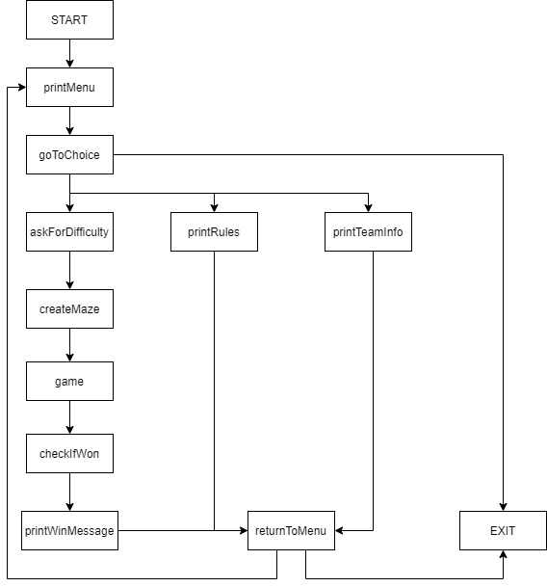
Flowchart of our game

Slide 7
Thank you for your attention!

